Slide 1
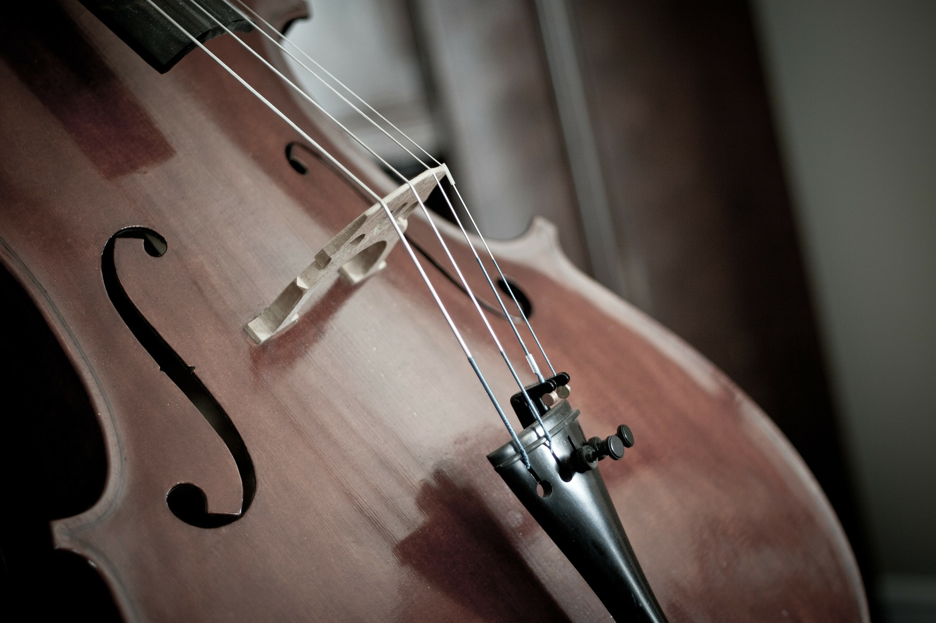
One into Another
A NIME By: Melanie Poland

Slide 2
How It Should Work
Performance Act
Plan
Play a well-known song with sensors on one arm and fingers
When the information from the sensors go into the computer, I want it to make a different song to be played together.

Slide 3
Supply List
3-4 sensors
Arduino
Adobe Audition for editing and playback
Sheet Music for songs

Slide 4
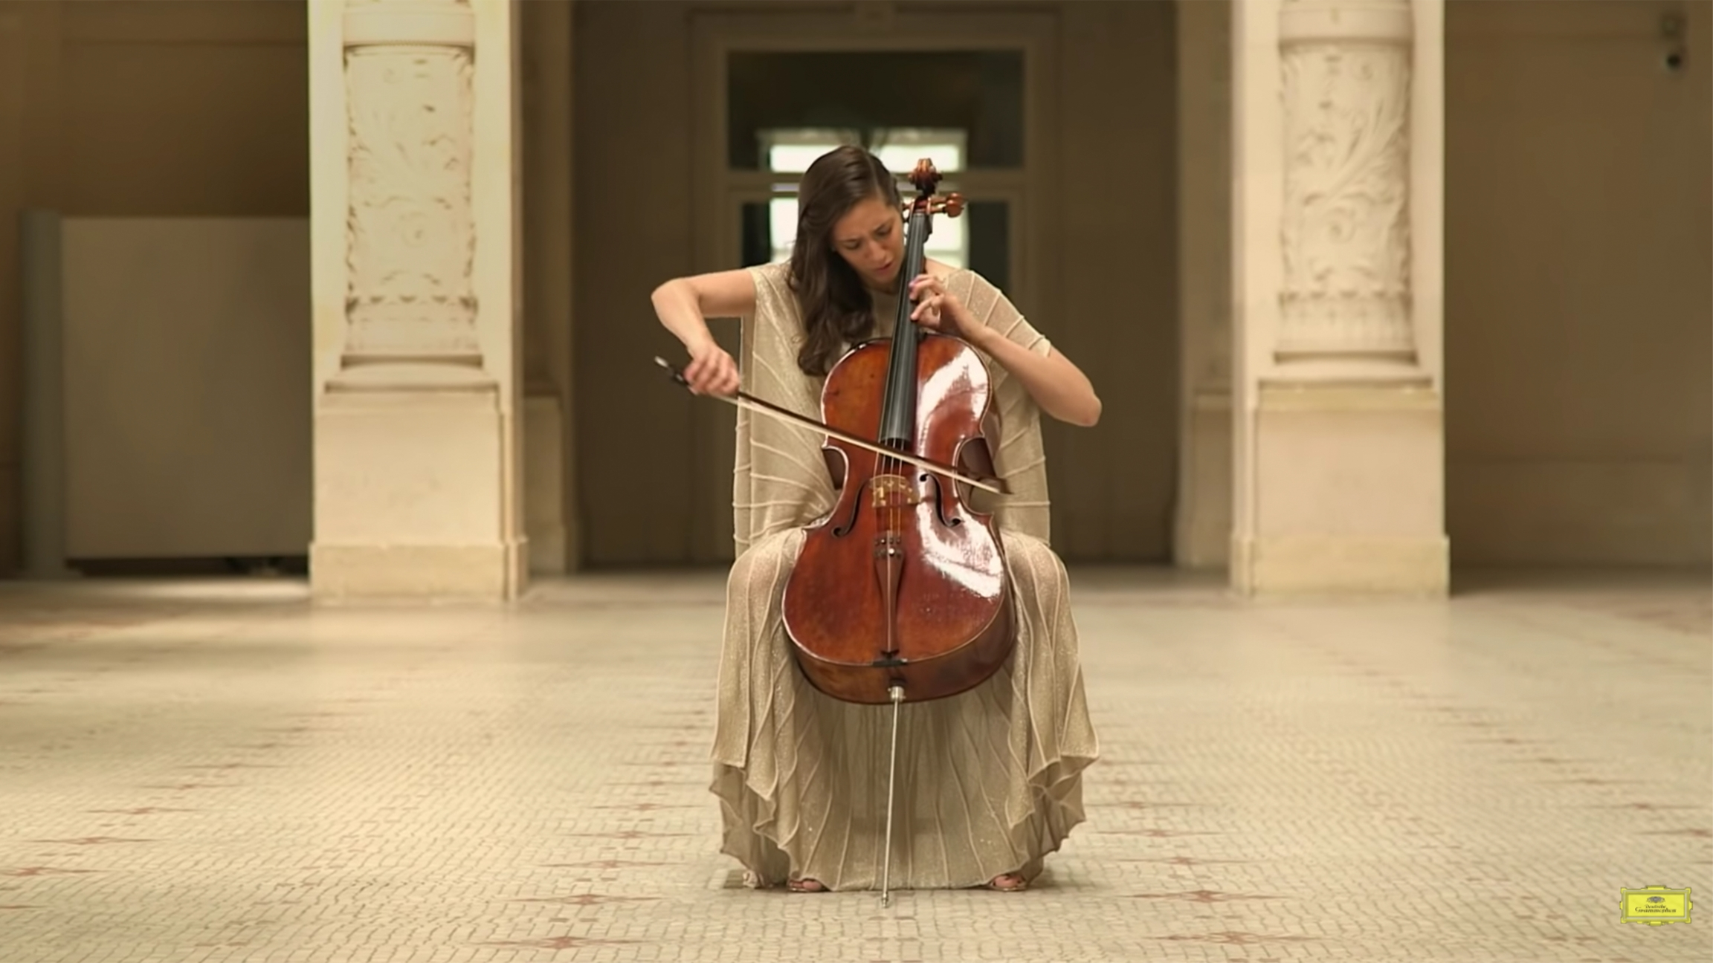

Slide 5
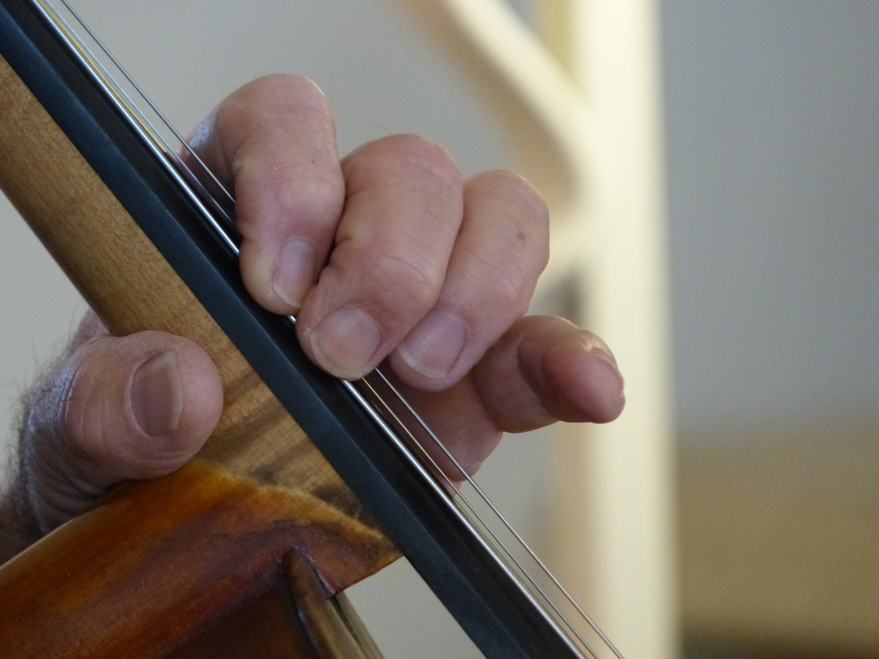



Slide 6
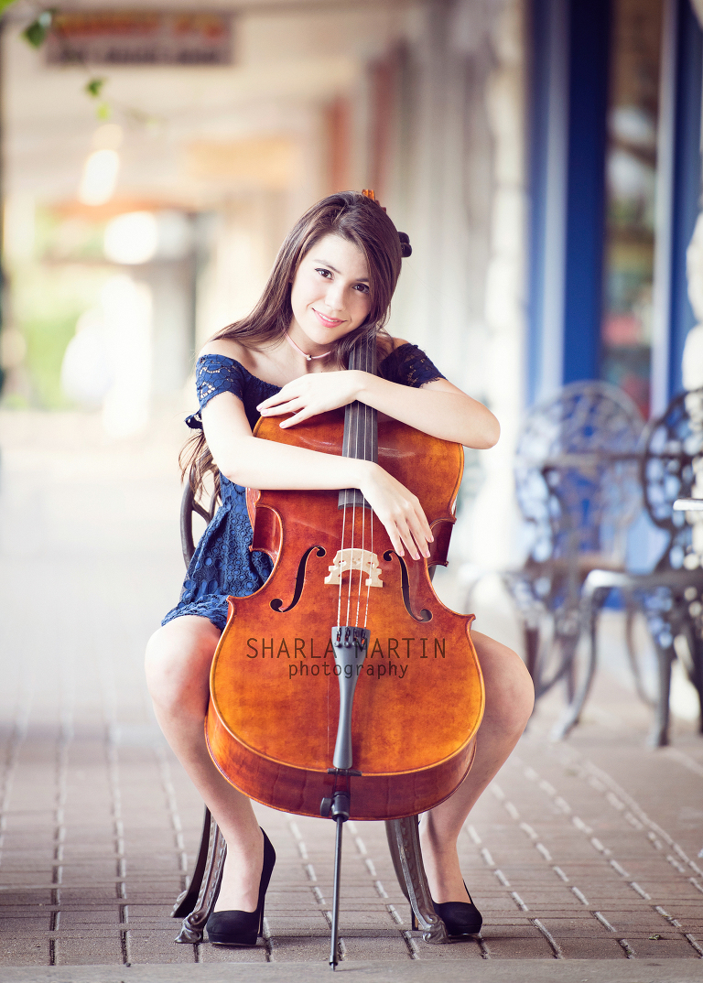

Possible Songs to Play
1
Game of Thrones Theme Song
Billie Eilish song
Any suggestions?

Slide 7
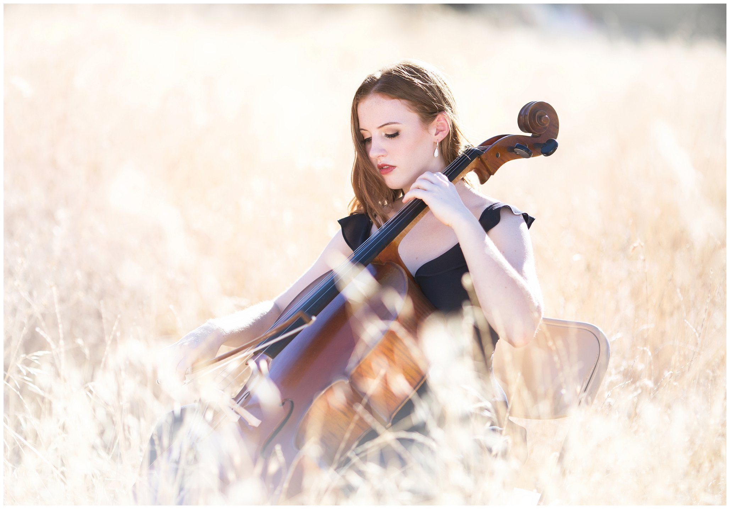
Thanks!
Any questions?

